Slide 1
Title of Project/internship
Presented
by
Student Name
Of
[Masters/Bachelors] of Computer Applications
under
Roll No. XXXXXXXXX
At
Company Name
Under the supervision of
Mr./Mrs. Name
Designation
Department of Computer Applications

Slide 2
Contents
ORGANIZATION INTRODUCTION.
PROJECT INTRODUCTION.
FIND THE MOVIES WITH HIGHEST PROFIT.
FIND THE BEST DIRECTOR.
FIND POPULER GENRES
SUM 0F NUM-VOTED-USER DECADE WISE

Slide 3
ORGANIZATION INTRODUCTION
Future Finders is a ground-breaking platform that develops young Indian talent that is motivated to advance and forge successful careers in IT. We provide a variety of courses to help you launch your career and locate the employer that will assist you as you rise to the top. Our expertise with the latest tools and techniques, and the experience of our professional experts help us deliver high-end services to our esteemed clients. Future Finders educates students and developers about the most recent technologies that are now popular. We are working on distributing informational know-how and offering clients specialized services following global best practices. At Future Finders, we recognize your unrivalled skill and help you realize your creative ideas. Our sole goal is to provide students with cutting-edge practical skills that will enable them to swiftly and effectively adapt to the constantly evolving technologies found in the business world. At Future Finders, our goal is to raise educational standards via innovation in both quality and practical knowledge.

Slide 4
PROJECT INTRODUCTION
IMDb-Clone is an impressive and meticulously designed movie database website built using React, Material-UI, and powered by the TMDB API. It offers users a seamless browsing experience to discover, and explore with a vast collection of movies.

Slide 5
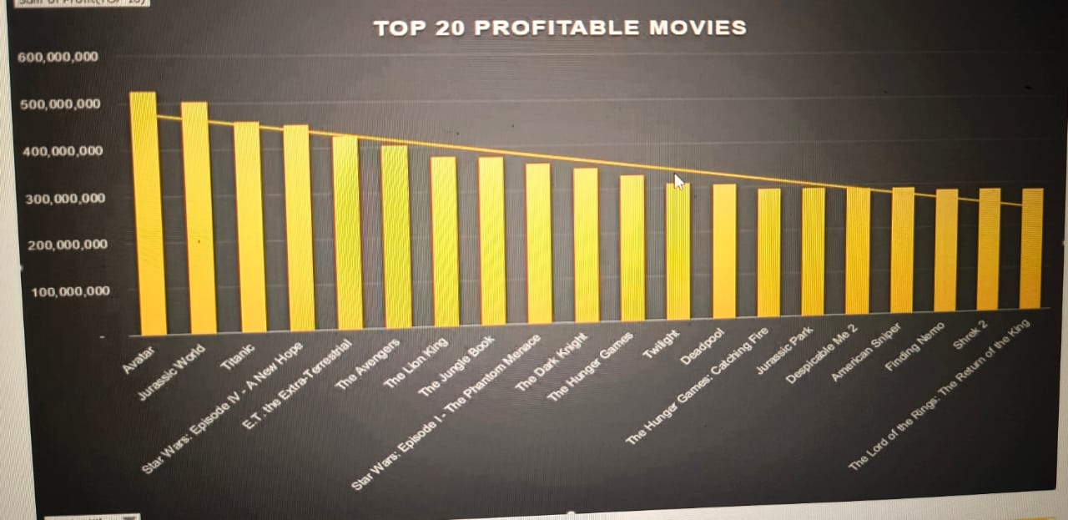
FIND THE MOVIES WITH HIGHEST PROFIT

Slide 6
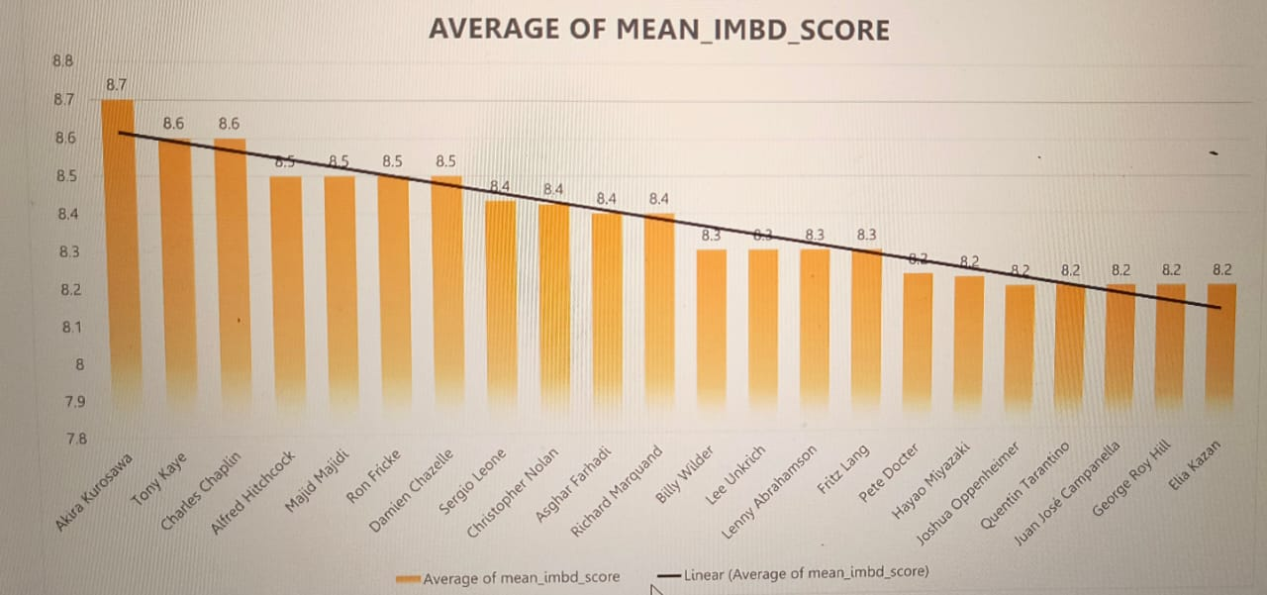
FIND THE BEST DIRECTOR

Slide 7
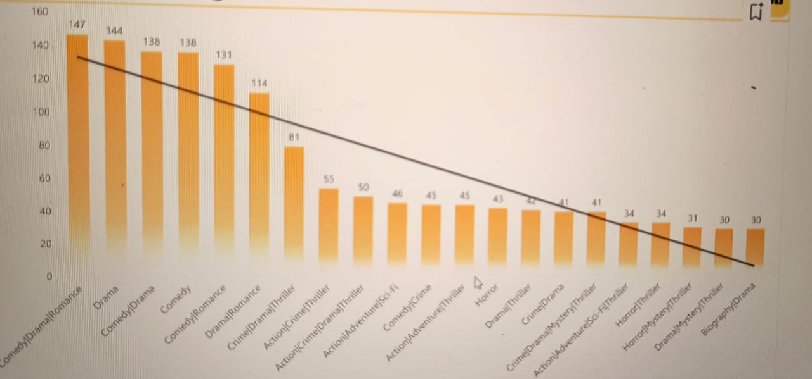
FIND POPULER GENRES

Slide 8
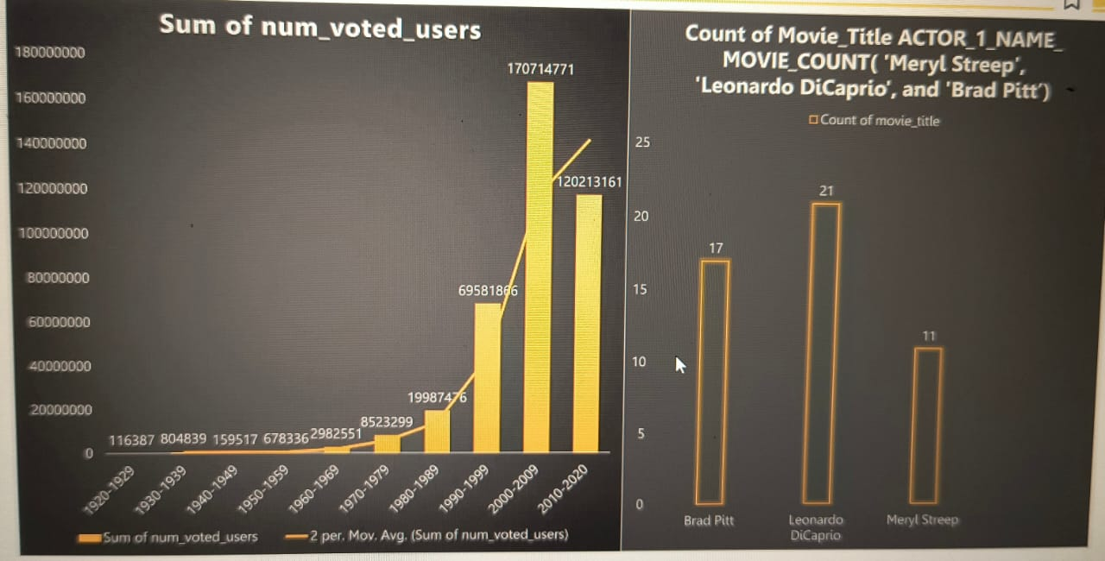
SUM 0F NUM-VOTED-USER DECADE WISE

Slide 9
THANK YOU

